Slide 1

E-Bid Book Seminar II JCIHK Award Program 2015 06th July 2015

Slide 2
About this Seminar
The Awards
What are the award categories
The Entries
Evaluation Criteria
Year Period of Project / Activity
Submissions
How to Submit an Award Entry?
Submission Procedure
Important Highlights

Slide 3
The Awards
The Entries
Submission

Slide 4

The Award
Award Types
JCI Awards
Award is allied to JCI Award Program
Local Awards
Award is available in Hong Kong Only

Slide 5
The Award
Chapter Levels
For Most Outstanding Chapter President and Best Chapter of the Area ONLY
Level 1: 25-55 members
Level 2: 56-90 members
Level 3: 91+ members

Slide 6
The Award
Award Categories
Group I : Individuals
Group II : Individuals - NOM
Group III A : LOMs
Group III B : LOMs - Special Awards

Slide 7
The Award
Group I

Slide 8
The Award
Group II

Slide 9
The Award
Group III A

Slide 10
The Award
Group III A

Slide 11
The Award
Group III B

Slide 12
The Awards
The Entries
Submission

Slide 13
The Entries
Eligibilities
Group l: Individuals
Group ll: Individuals - NOM
Group III A: LOMs
Group III B: LOMs – Special Award
Only 1 entry for each award
1 project for 1 entry

Slide 14
The Entries
Evaluation Criteria
Example:
Best Community Empowerment Program
JCI Judging Points | Points
Objectives, Planning, Finance and Execution | 20
Membership Participation | 15
Community Impact | 30
Impact on Local Organization | 15
Long-term Impact of the Program | 20

Slide 15
The Entries
Award Year
The “Awards Year” starts from one month prior to the 2014 Junior Chamber International Hong Kong National Convention to one month prior to the 2015 National Convention. The date of the Opening Ceremony will be used for this:
25 August, 2014 to 11 August, 2015
Must complete any program or project submitted for an award during the current award year
For continuing programs and projects, a major portion of the activity should have been taken place during this period

Slide 16
The Awards
The Entries
Submission

Slide 17
Submission
Softcopy
Each e–bidbook must be uploaded to the JCI platform (www.jci.cc/hongkong)
with an approved electronic entry e.g. memory stick or CD-ROM
Hardcopy
Only system generated hard copy is acceptable.
Awards entries must be created and edited by using the software on the JCI website.
Must be certified, true and correct by the LOM President no later than 8:00 p.m. on 24 August, 2015 (Monday) and dated, signed by NRRD Lewis Kan or Chamber Office Staff for acknowledgement.
5 marks will be deducted for all entries from the chapter for late submission.
Will not be accepted after 8:30 pm of the day.

Slide 18
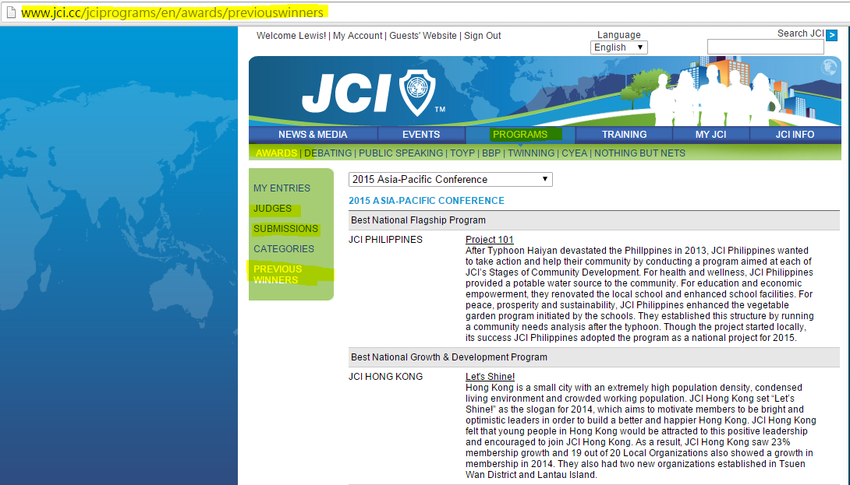
Submission

Slide 19

Submission
Awards
Submission Requirements
Use cover page provided by NOM
Completed Basic Information
Plain Layout is preferable
4 images in each session (A4 size)

Slide 20
Submission
When & How ?
When?
24th August, 2015 (Monday)
No later than 8pm (rthk.hk time announcement)
By Hard Copy (5 Marks will be deducted if late submission, Hard copy will not be accepted after 8pm of the day.)
How?
Create & Edit Entry :
1. by the web tool (www.jci.cc)
2. by the format system generated
Confirm your online entry by 24th August, 2015 (20:00)
Submit hard copies to JC office with electronic copy (as backup)
Completed entry must be approved by LOM Ps

Slide 21
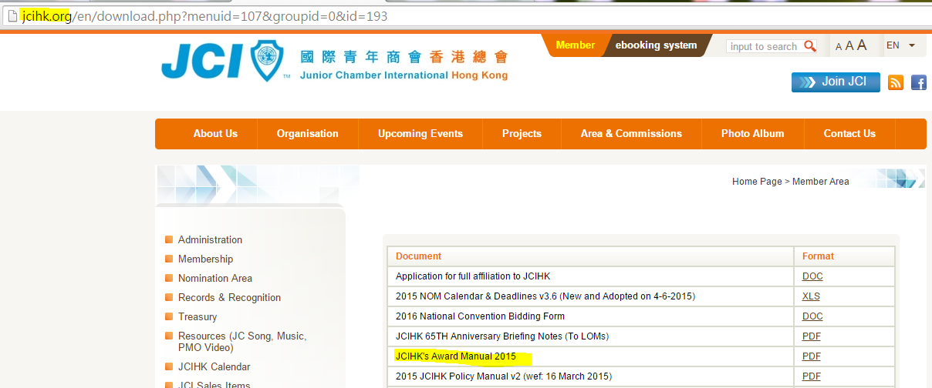
Reference
1. Go to jcihk.org
2. Go to “member” → “Resources”
3. Go to “Adminstration”
4. Download “JCIHK's Award Manual 2015”

Slide 22
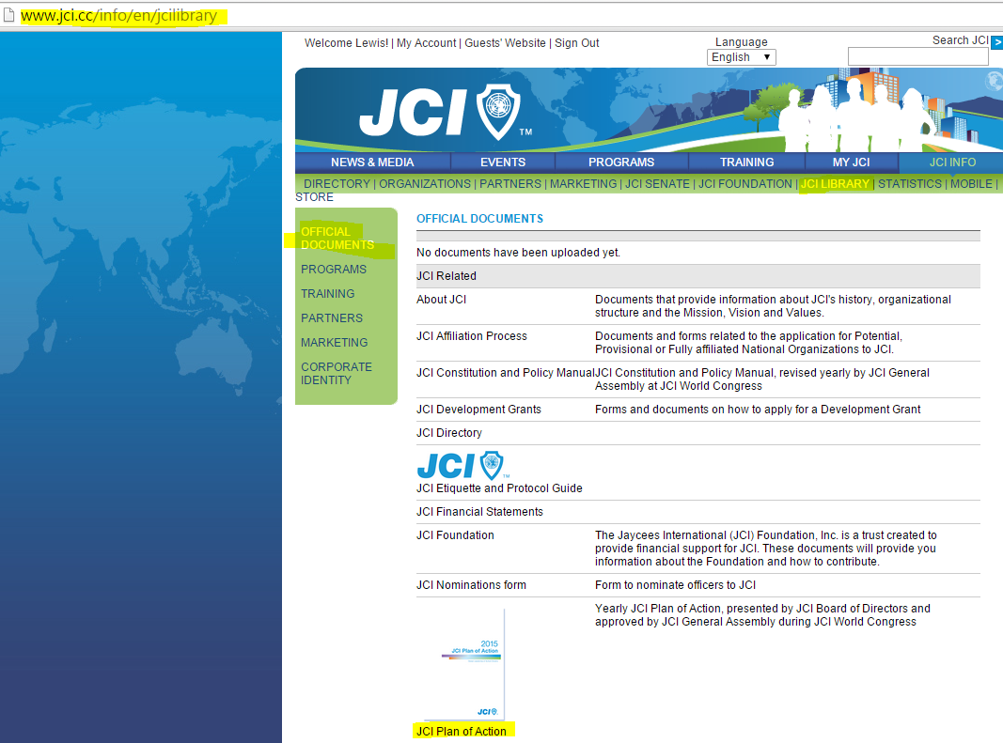
1. JCI.CC
2. JCI library
3. Official Documents
4. JCI Plan of Action

Slide 23
Submission
Important Deadlines
Important Deadlines
Nomination of Award Judge | Aug 01, 2015 23:59 (Sat)
Pre-Entry Summary Submission | Aug 11, 2015 23:59 (Mon)
Submission Deadline (Hard copy and Soft copy) | Aug 24 2015 (Mon) (by 20:00 RTHK)
Award Judge Briefing (Failing to attend such briefing shall be disqualified) | Aug 28, 2015 (Fri) JCIHK Office Seminar 1 & 2
Award Judging Day | Aug 30 2015 (Sun) Full day (09:00 till judging finished) JCIHK Office Seminar 1, 2 & 3
Notes:
- 1 hard copy (coloured with good print quality)
- Save your e-bidbooks in a USB
submit to JC Office
-Judges (including NOM Executive Member) Shall attend a briefing session to be convened by the NRRD, failing to attend such briefing shall be disqualified.
Award Judging Day: All nominated judges must be present Nominated judges have to bring his/ her own notebbok

Slide 24
Submission
Useful Links
JCI Website: for submission of e-Bid Books
http://www.jci.cc/local/hongkong
JCIHK Website
http://www.jcihk.org → Members → Resources → Administration // Records & Recognition

Slide 25
Judging Panel
Nominate at least one award judge
Max 3 nominees
Not less than 2 years of JCI experience or shall have been the board member or current members in the board
Should have both judging experience and have experiences on bidbook compilation
Must not be the current President of the LOM

Slide 26
Enquires
2015 NRRD Lewis Kan
Email : lewis.kan@jcihk.org
Mobile : (852) 9625 3207
2015 NSG Senator Olive Chan
Email : olive.chan@jcihk.org
Mobile: (852) 9832 2997

Slide 27
END
Thank you!

