Slide 1
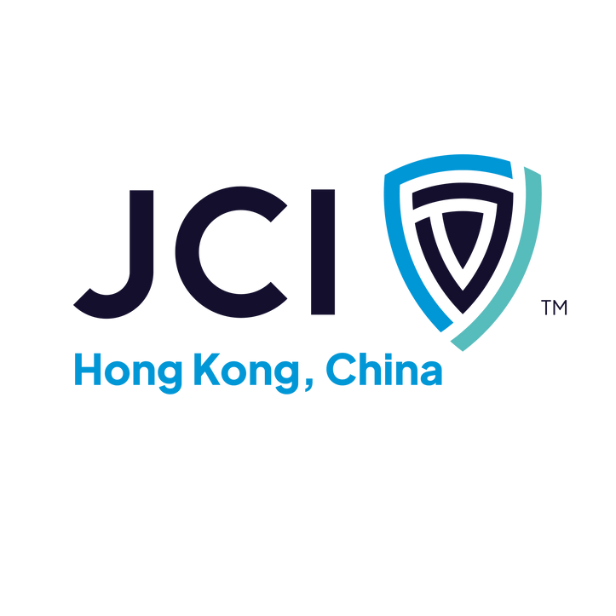



Slide 2


JCI CREED
WE BELIEVE…
That faith in God gives meaning and purpose to human life;
That the brotherhood of man transcends the sovereignty of nations;
That economic justice can best be won by free men through free enterprise;
That government should be of laws rather than of men;
That earth's great treasure lies in human personality;
And that service to humanity is the best work of life.

Slide 3
JCI MISSION
To provide leadership development opportunities that
empower young people to create positive change.
JCI VISION
To be the foremost global network of young leaders.

